Slide 1
Alzheimer Disease Prediction

Slide 2
Presented by:
Asmaa Abdelfattah Mohammed
Hayam Tarek Fathy
Nada Shaban
Shrouk saeed
supervisor:
Dr. Sameh Basha

Slide 3
Problem Statement
Related work
Proposed Model
Data set
Introduction
Data Pre-Processing
Models
Keras Neural Network
Cross-Validation

Slide 4
Introduction

Slide 5
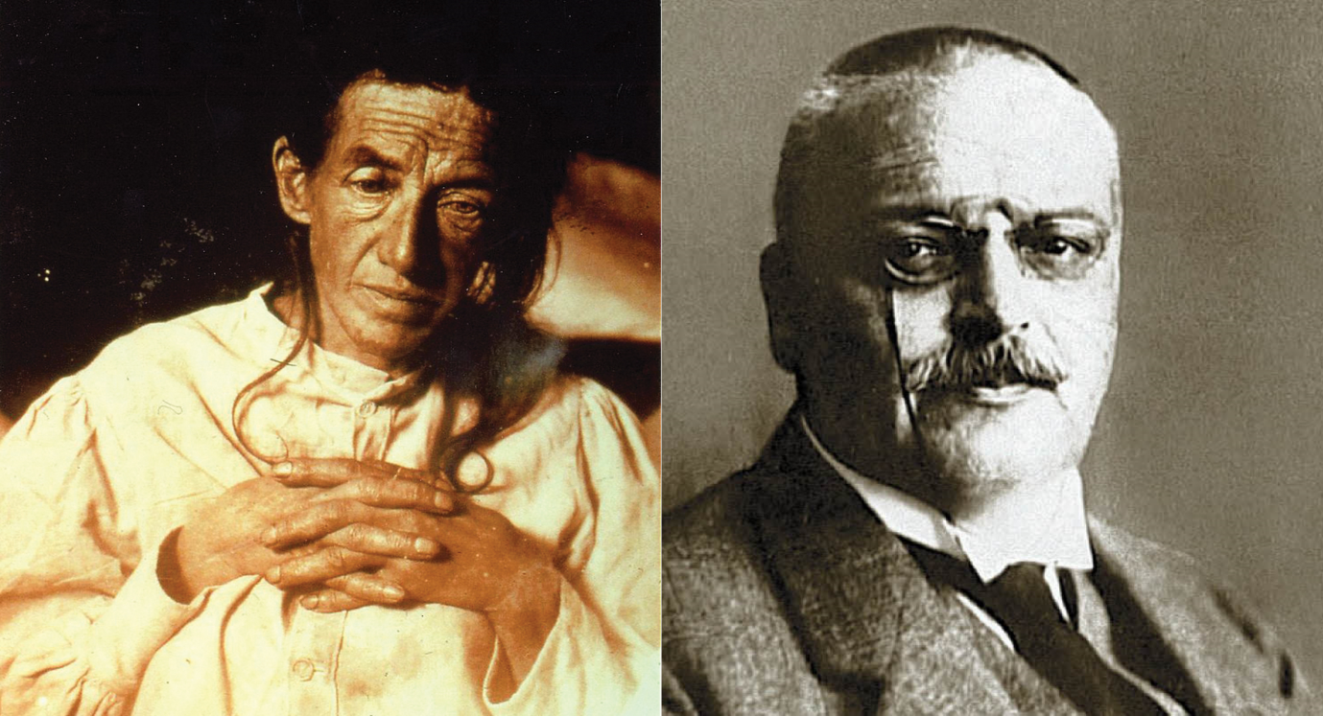
History of Alzheimer
Alzheimer’s disease is named after Dr. Alois Alzheimer In 1906 noticed changes in the brain tissue of a 56 Y.O woman who had died of an unusual mental illness.
Alzheimer’s disease is currently ranked as the seventh leading cause of death in the United States and is the most common cause of dementia among older adults.
Many organizations form around the world to raise funds for Alzheimer's research and increase awareness of people living with Alzheimer's disease and their caregivers.
There is currently no cure for Alzheimer's disease however, doctors prescribe medications to reduce symptoms such as anxiety and depression.

Slide 6
Problem Statement

Slide 7

Alzheimer Definition:
A type of dementia which is a neurological disorder that occurs through proteins in the brain that do not perform their function normally.
Affecting the work of brain cells, releasing a series of toxic substances,
Then nerve cells are damaged which leads to contraction of the brain .

Slide 8
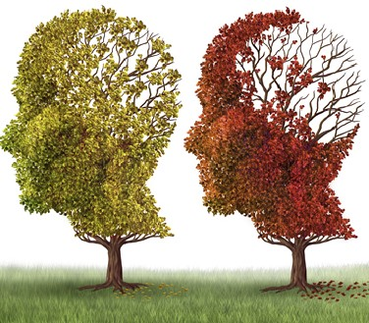
Alzheimer Syndromes
imbalance in memory
forgetting some conversations and daily events
depression
social withdrawal and loss of confidence in others
when the disease reaches advanced stages
uncontrol in swallowing
uncontrol of bowel
Fainting
bed sores

Slide 9
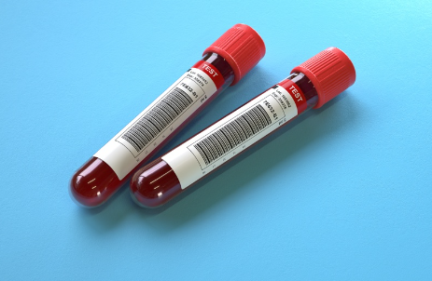
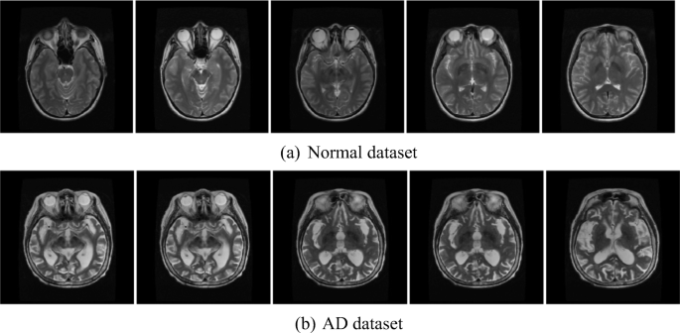
The role of machine learning in diagnosing Alzheimer
MRI to determine the size of the brain contraction
CT X-ray to exclude tumors , brain strokes and head injuries
Blood tests to check Thyroid function and vitamins

Slide 10
Related work

Slide 11
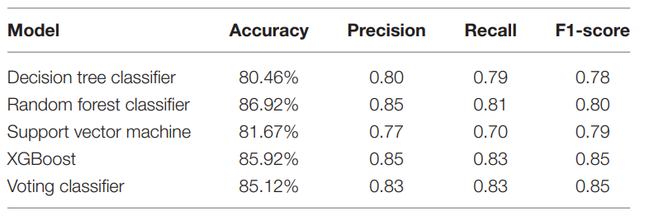
Early stage Alzheimer’s diseases prediction using machine learning models AT vit university 2022
Alzheimer diseases is progressive neurological condition that leads to short term memory loss which lasts for years or the rest of life, So early detection controls brain damage to great extent.
Detection by applying on data some algorithms Such as
SVM
Random Forest classifier
decision tree
voting classifier

Slide 12
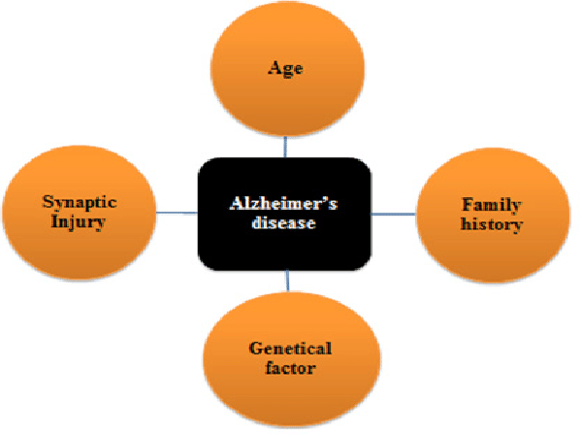
They concludes causes of Alzheimer:
1. It is more likely for men to have demented, or Alzheimer’s Disease, than for women.
2. In terms of years of education, demented patients were less educated.
3. Brain volume in non-demented groups is greater than in demented groups.
4. Among the demented group there is a higher concentration of 70-80-year-olds than in the non-demented patients.

Slide 13
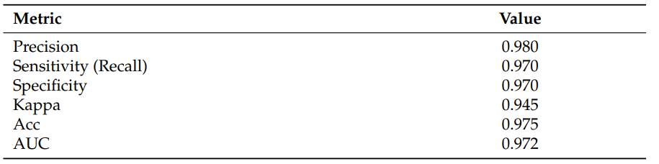
Machine Learning Framework for the Prediction of Alzheimer’s Disease Using Gene Expression Data Based on Efficient Gene Selection
In recent years, much research has focused on using machine learning (ML) for disease prediction based on gene expression (GE) data.
The present work is intended to fill the gap of data shortage by introducing a symmetric framework to predict AD from GE data, with the aim to produce the most accurate prediction using the smallest number of genes.
Materials and Methods :
Integration of Datasets ,
Preprocessing ,
Gene Selection (GS) : {Chi squared (χ 2 ) , Analysis of variance (ANOVA) , Mutual Information (MI) } ,
Classification: {SVM , RF , LR } .
The contribution of this article is multifaceted as follows:
• A comprehensive framework to diagnose AD from GE data;
• A novel GS methodology based on hybrid filter/wrapper selection methods;
• The use of 6 different performance metrics to evaluate the proposed framework;
• High-performance exceeding, as demonstrated by experimental results, state of the art GE-based AD prediction frameworks;
• An enrichment to the literature on AD prediction based GE data, which is admittedly poor compared to the literature on other diseases.

Slide 14
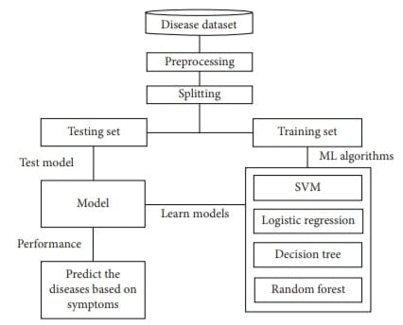
A Comparative Analysis of Machine Learning Algorithms to Predict Alzheimer’s Disease
-Alzheimer’s syndrome is an inherited, irreversible brain condition that steadily affects the ability to perform the necessary things, memory, and reasoning skills.
-The OASIS dataset has been used in the system , which contains all the attributes and values.
DATA PREPROCCESSING
There are several categorical values present in the dataset. Among them, gender and group attribute columns are converted into numeric values 0 and 1.
The dataset is checked for any null or missing values, the missing values of those rows were not deleted. Instead, the median value is used to fill in those missing values for these features.
Then, the dataset was split for training validation and testing.

Slide 15
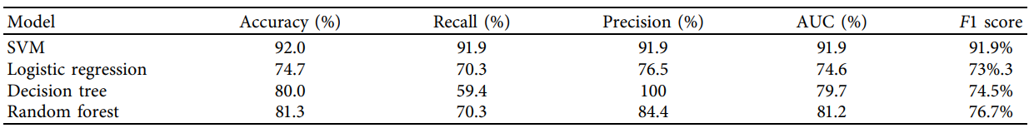
-Random sampling has been used for the split, but this creates an imbalance between training and testing split .
So, stratified sampling has been applied with a training-validation size of 80% and a testing size of 20%.
After that, standardization has been applied to do the scaling of the features
-The dataset has been analyzed and applied in several machine learning models:
Support vector machine(SVM), logistic regression, decision tree , and random forest have been used for prediction.
Comparing the results, it is found that the support vector machine provides the best results among the models.
It has the best accuracy in detecting Alzheimer disease

Slide 16
Proposed Model

Slide 17
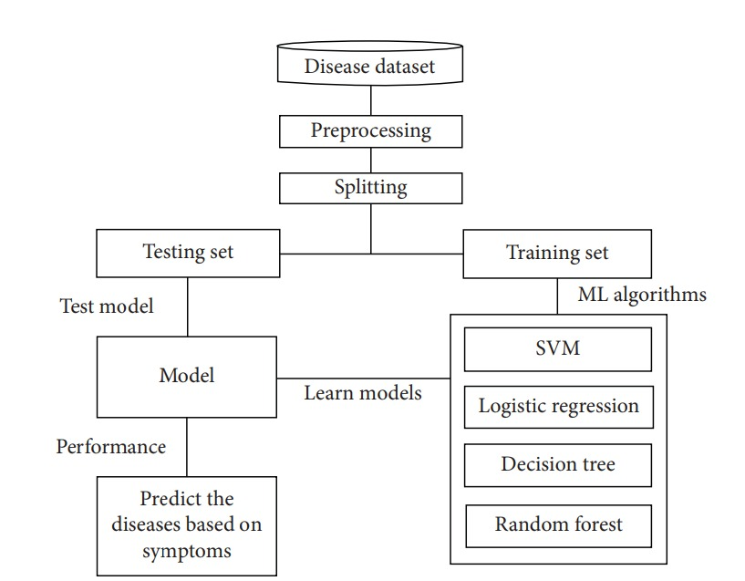
Machine Learning Proposed Model

Slide 18
Data Set

Slide 19
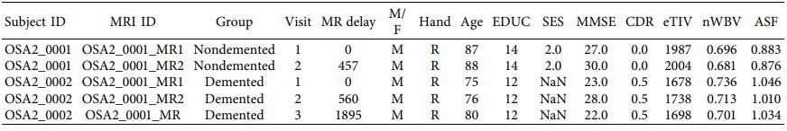
The Open Access Series Of Imaging Studies(OASIS)
The main goal of the system is to predict Dementia in different patients based on various attributes. longitudinal Magnetic Resonance Imaging (MRI) data from OASIS has been used for the development of the system.

Slide 20
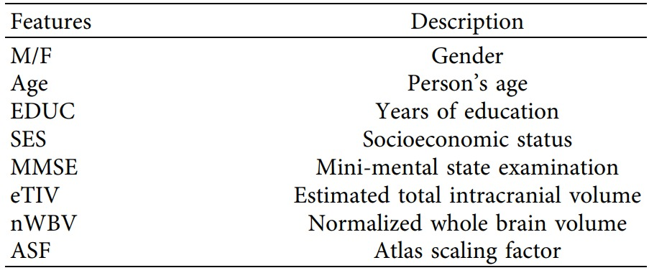
The eight features of the dataset which have been considered for the proposed model to predict Alzheimer’s disease and the description of the features.

Slide 21
Data Pre-Processing

Slide 22
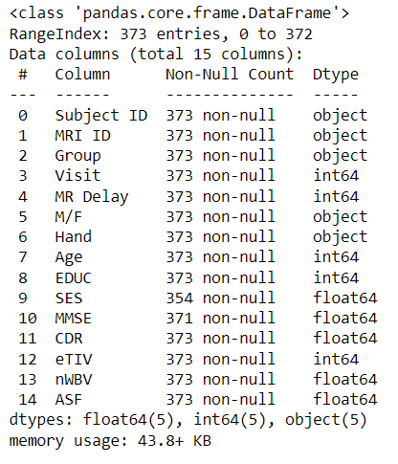
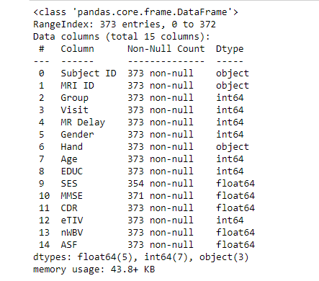
Converting Categorical Data to Numerical Data in columns
gender and group attribute columns are converted into numeric values 0 and 1.

Slide 23
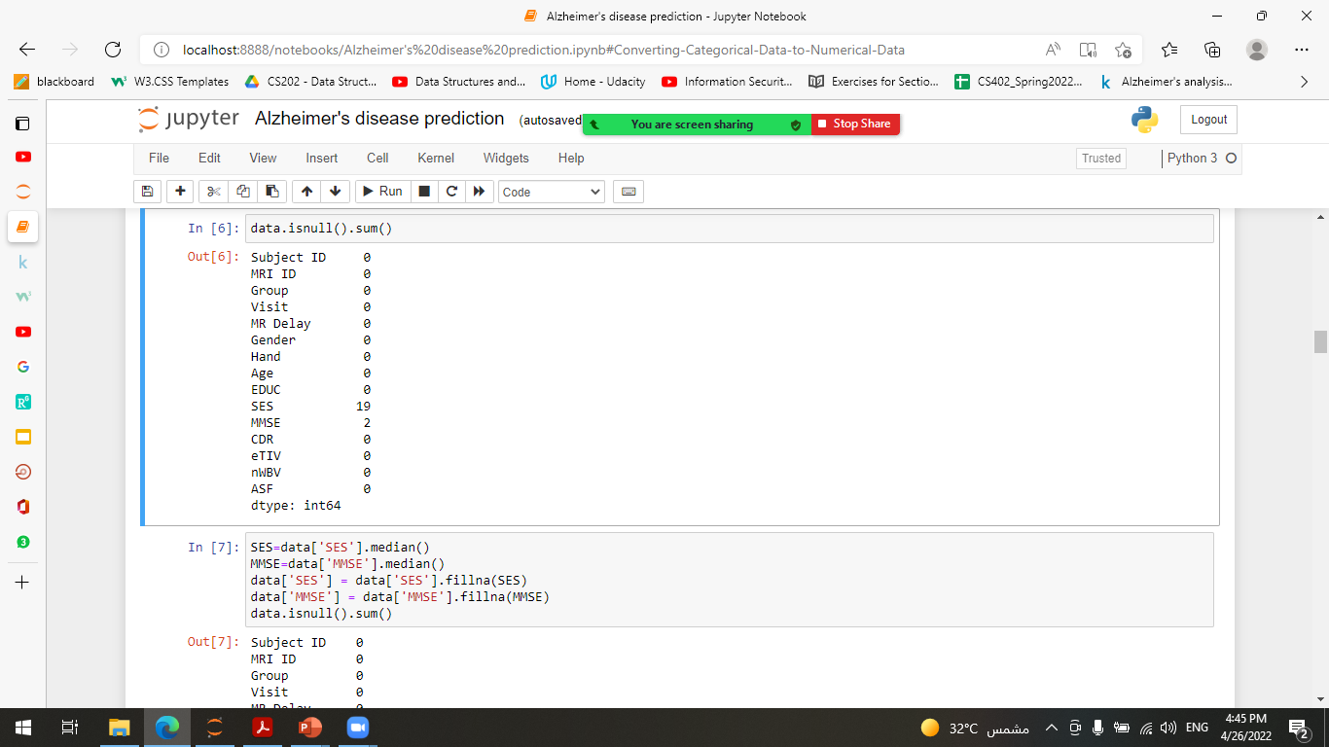
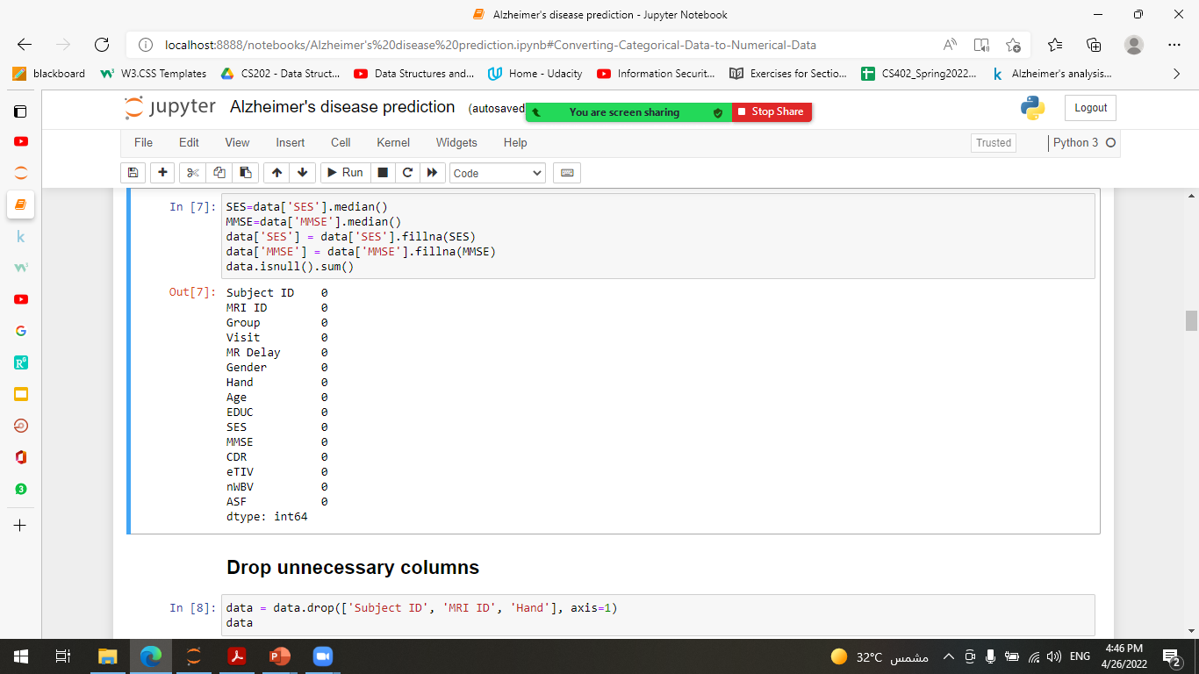
Checking for any null or missing values.
The median value is used to fill in those missing values for features.

Slide 24
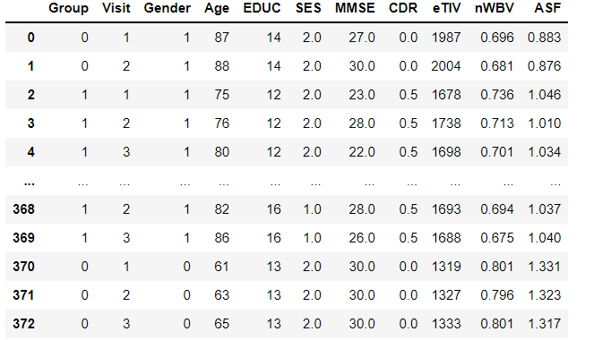
Drop unnecessary columns
Drop Subject ID , MRI ID, Hand Columns because they do not affect on the output (The Target Value “Group”)

Slide 25
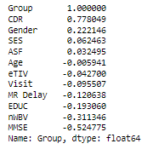
Correlation matrix
the correlation between attributes has been checked by using the “correlation matrix” function based on group attributes.

Slide 26
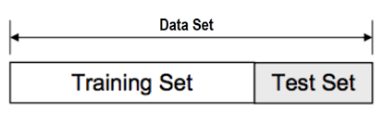
Data Splitting
stratified sampling has been applied with a training-validation size of 80% and a testing size of 20%.To evaluate the performance of the machine using unknown data

Slide 27
Data Visualization

Slide 28
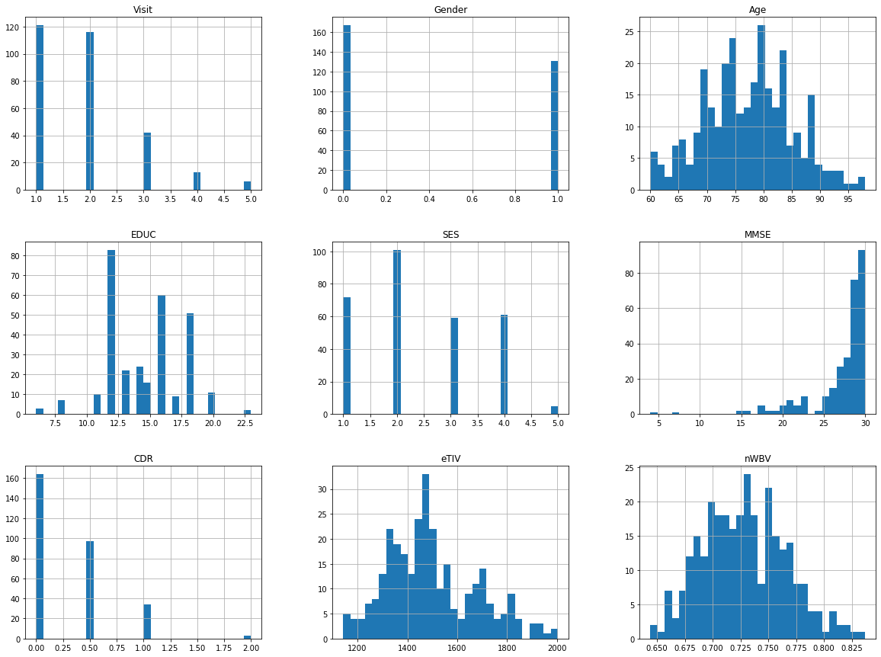
Histogram to visualize Data
shows the histogram of the training and validation set.
Histogram portrays the ratios of the dataset.

Slide 29
Methods
SVM
Logistic Regression
Decision Tree
Random Forest

Slide 30
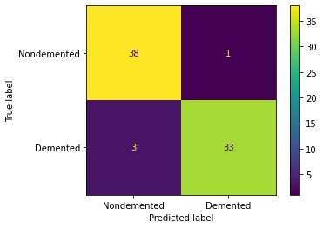
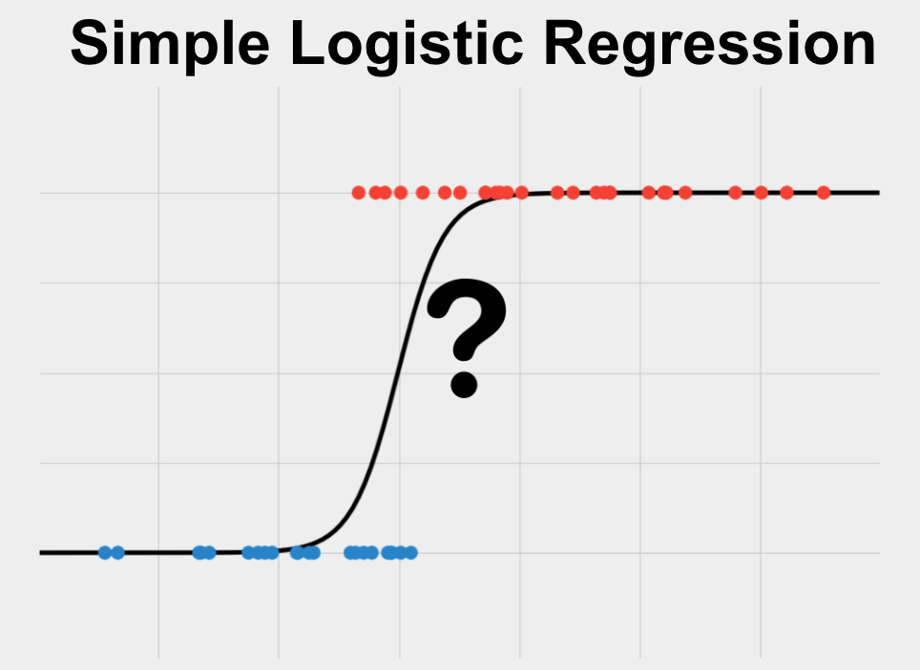
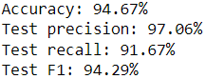
Logistic Regression Model
Logistic regression is a supervised learning algorithm used in machine learning to predict the probability of a binary outcome. A binary outcome is limited to one of two possible outcomes. Examples include yes/no, 0/1 and true/false.

Slide 31
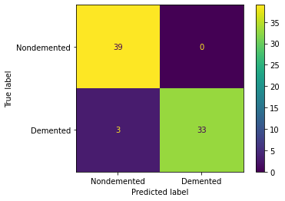
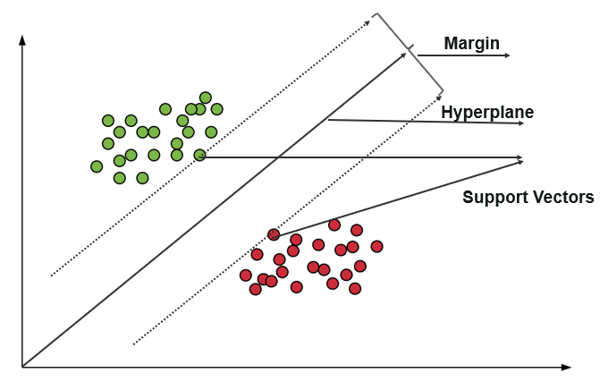
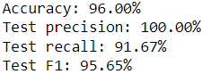
SVM Model
Support vector machines (SVMs) are a set of supervised learning methods used for classification, regression and outliers detection. we perform classification by finding the hyper-plane that differentiates the two classes very well (look at the below snapshot).

Slide 32
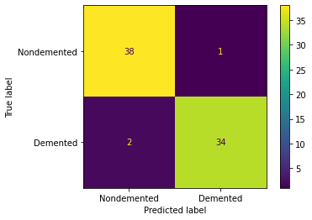
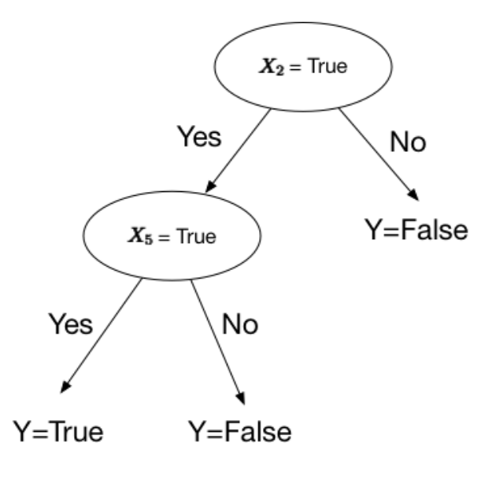
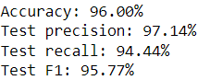
Decision Tree Model
Decision Trees are a type of Supervised Machine Learning where the data is continuously split according to a certain parameter.

Slide 33
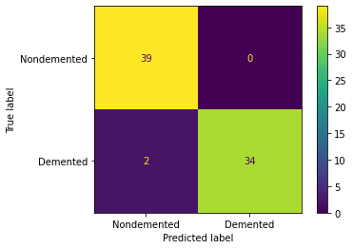
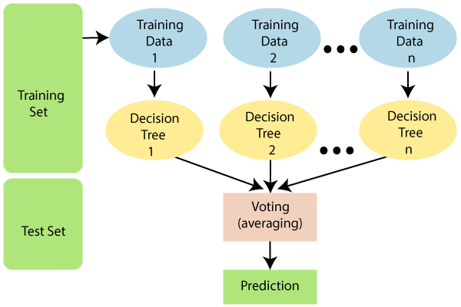
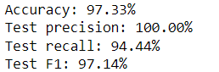
Random Forest Model
A classifier that contains a number of decision trees on various subsets of the given dataset and takes the average to improve the predictive accuracy of that dataset.

Slide 34
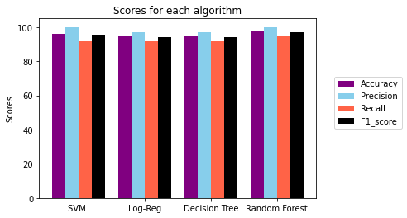
Bar chart of Classifiers

Slide 35
Cross-Validation

Slide 36
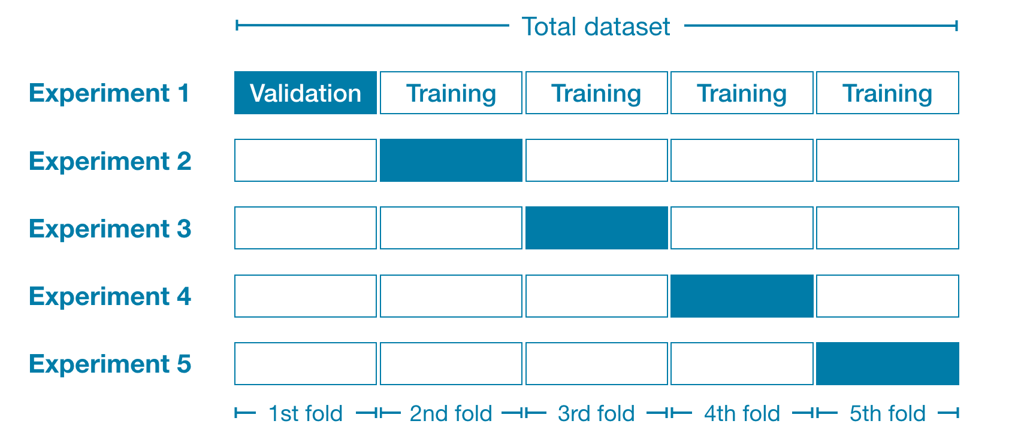
What is Cross-Validation ?
Cross-validation is a resampling method that uses different portions of the data to test and train a model on different iterations.
It is mainly used in settings where the goal is prediction.
The goal of cross-validation is to test the model's ability to predict new data that was not used in estimating it, in order to flag problems like overfitting .

Slide 37
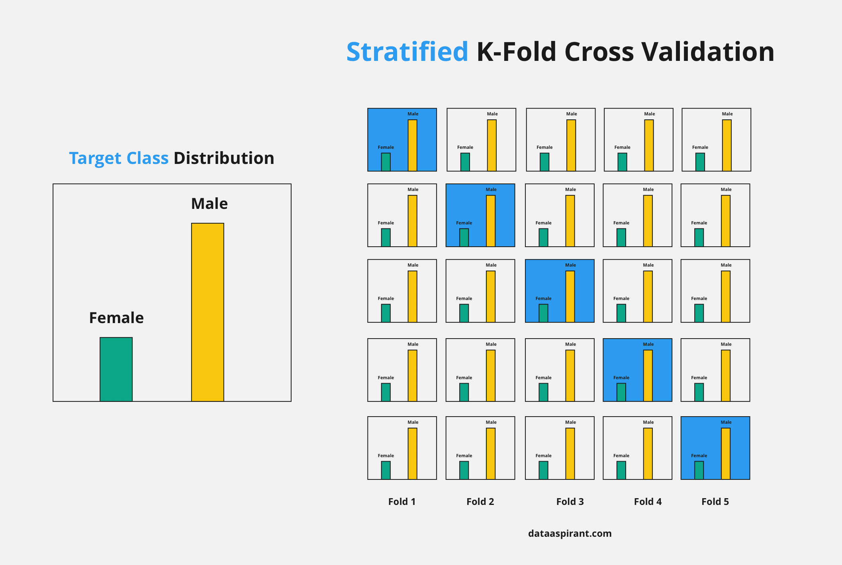
K-Fold Cross-Validation
The procedure has a single parameter called k that refers to the number of groups that a given data sample is to be split into. As such, the procedure is often called k-fold cross-validation.
The stratified k fold cross-validation :
Stratified k-fold cross-validation is the same as just k-fold cross-validation, But Stratified k-fold cross-validation, it does stratified sampling instead of random sampling. 5-fold cross-validation has been applied to evaluate all possible combinations.

Slide 38
Cross Validation for each model
SVM-Model | Log-Reg | Decision Tree | Random Forest
Cross Validation Scores are [0.96 0.90666667 0.94666667 0.94594595 0.95945946] Accuracy:0.944 | Cross Validation Scores are [0.90666667 0.93333333 0.94666667 0.94594595 0.97297297] Accuracy:0.941 | Cross Validation Scores are [0.90666667 0.89333333 0.89333333 0.93243243 0.86486486] Accuracy:0.898 | Cross Validation Scores are [0.90666667 0.93333333 0.94666667 0.94594595 0.97297297] Accuracy:0.941

Slide 39
Keras Neural Network

Slide 40
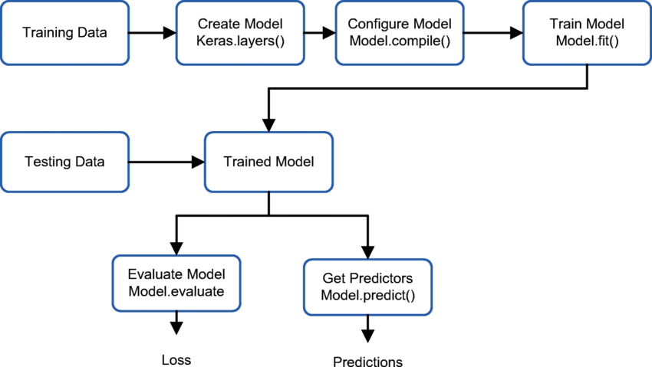
Keras Proposed Model

Slide 41
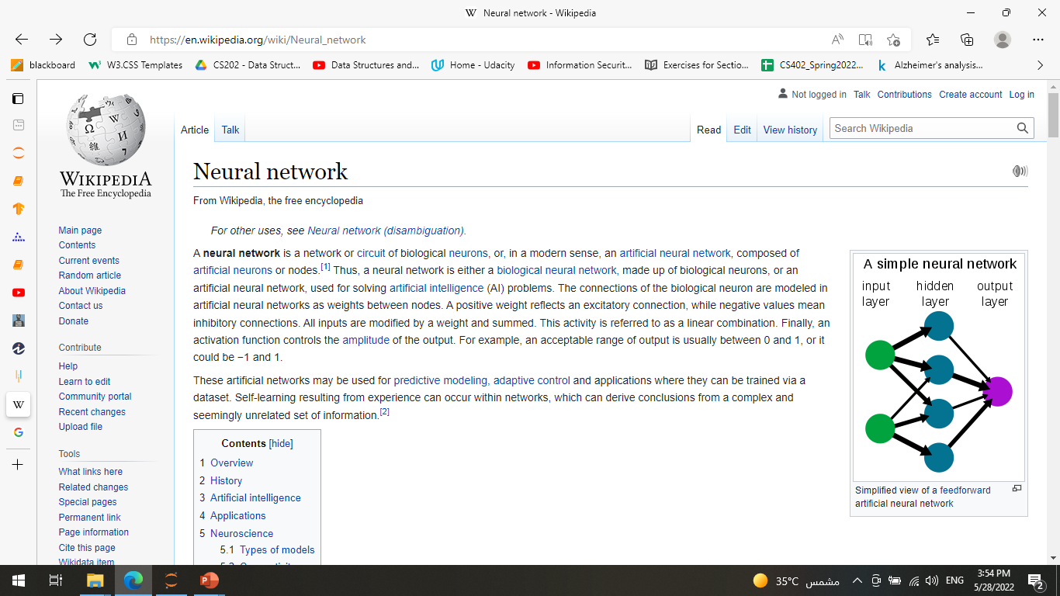
What is neural Network?
A neural network is a series of algorithms that seeking to recognize underlying relationships in a set of data through a process that mimics the way the human brain operates.

Slide 42
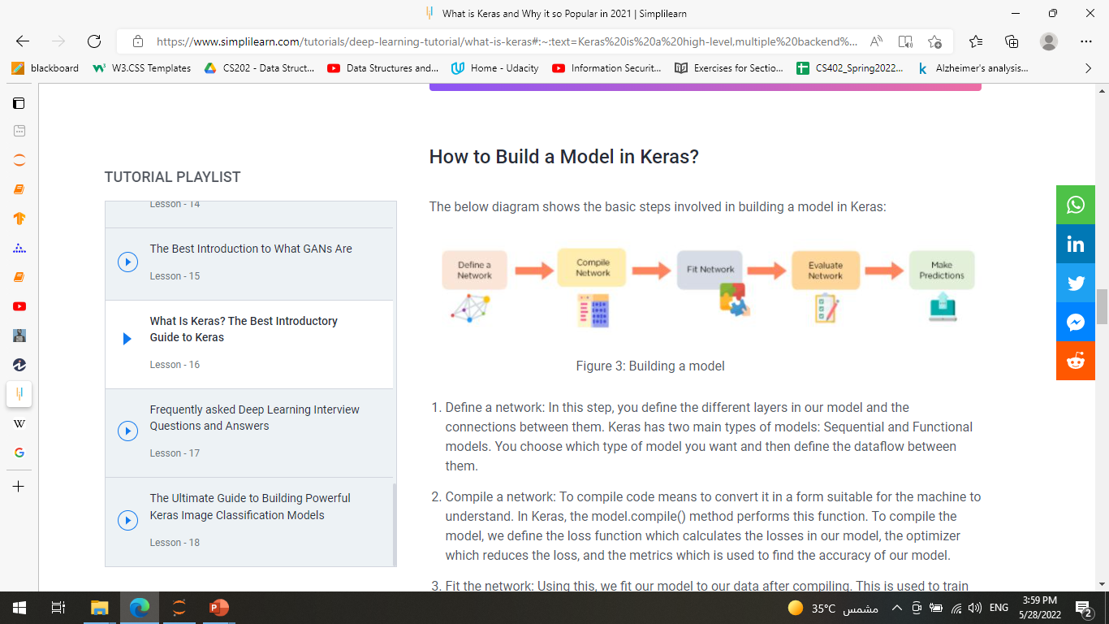
What is keras And how to build?
Keras is a high-level, deep learning API developed by Google for implementing neural networks. It is written in Python and is used to make the implementation of neural networks easy.

Slide 43
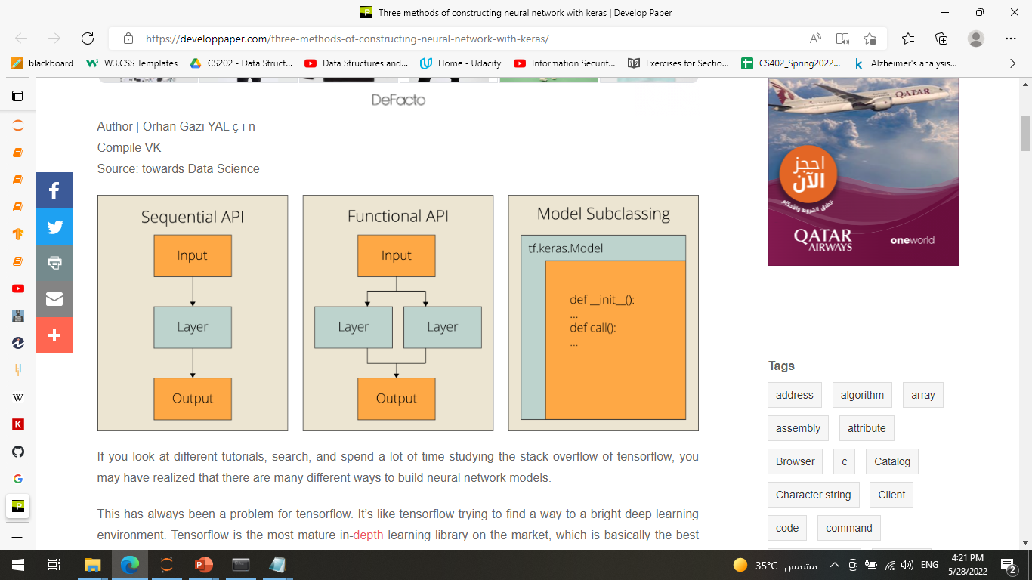
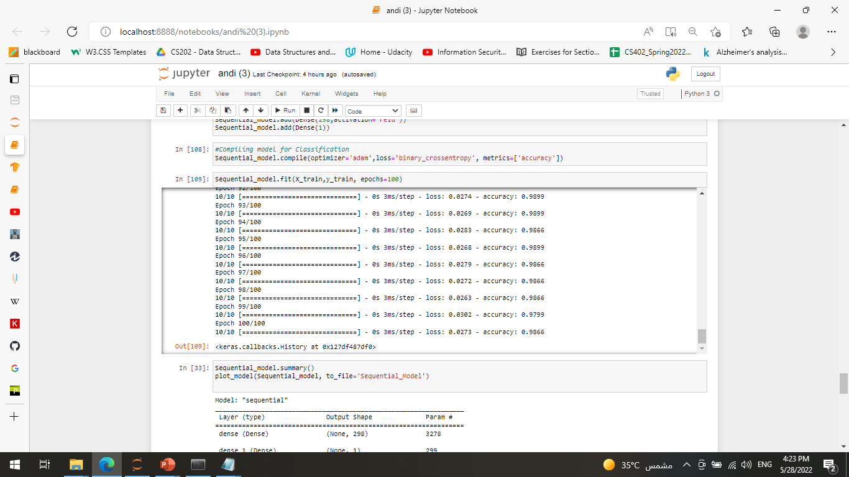
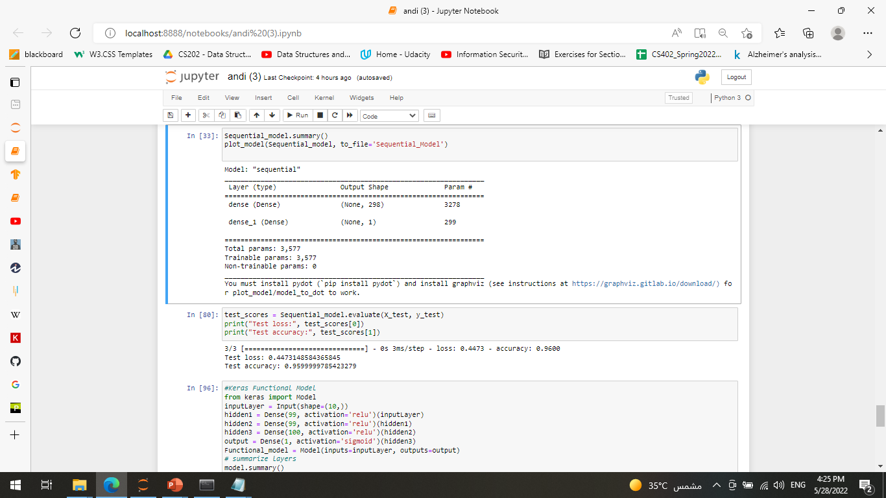
Sequential Model
The sequential model is a linear stack of layers.

Slide 44
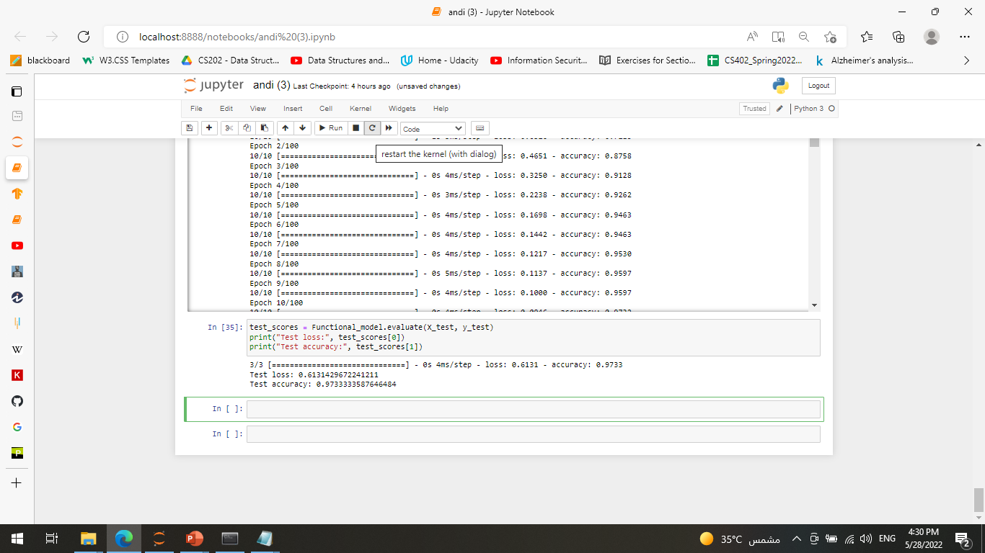
Functional Model
The Keras functional API is a way to create models that are more flexible than the Sequential API.
The functional API can handle models with non-linear topology, shared layers, and even multiple inputs or outputs.

